Slide 1
Basic Computer Architecture
Unit 3

Slide 2
Computer Architecture
Computer Architecture refers to those attributes of a system visible to a programmer or, put another way, those attributes that have a direct impact on the logical execution of a program.
Computer Organization
Computer organization refers to the operational units and their interconnections that realize the architectural specifications.

Slide 3
History of Computer Architecture

Slide 4
Computer Architecture
The design ,arrangement, construction or organization of the different parts of a computer system is known as Computer Architecture
Computer architecture defines the way hardware components are connected together to form a computer system
Computer architecture deals with high level design issues such as Instruction sets, Addressing modes, Data types, Cache optimization etc.
It helps us to understand the functionalities of a system.
It acts as an interface between hardware and software

Slide 5
Brief History of Computer Architecture
First Generation (1945-1958)
Vacuum Tubes
Machine code
CPU was unique to that machine
Use of drum or magnetic core memory, programs are loaded using paper tape or punch cards
2 Kb memory, 10 KIPS(thousands instruction per second)

Slide 6
Architecture for a Computing Machine
Based on the storage and signaling of instruction and data.
Harvard architecture: uses physically separate storage and signal pathways for instructions and data. (Harvard Mark I). it stored instructions on punched tape and data in relay latches.
Von Neumann architecture: a single storage structure to hold both set of instructions and data Aka stored program computers.

Slide 7
Second Generation(1958-1964)
Transistors – small, low-power, low-cost, more reliable than vacuum tube
Magnetic core memory
Reduced computational time to microseconds
High level languages
First OS handled one program at a time

Slide 8
Third Generation(1964-1974)
Integrated circuits, combined thousands of transistors on a single chip using LSI
Semiconductor Memory
Timesharing, Graphics and Structured programming
2 Mb memory, 5 MIPS
Use of Cache memory

Slide 9
Fourth Generation(1974- Present)
Microprocessor, combined millions of transistors using VLSI and ULSI technology
Single Chip processor and the single board computer emerged
Creation of the Personal computer(PC)
Object oriented programming and Artificial intelligence concept
Intel 4004 was the worlds first universal microprocessor.

Slide 10
Self Study !!
ENIAC
Whirlwind computer
UNIVAC
IBM 7090
IBM System/360
Intel 4004

Slide 11
Microoperations
The operation executed on data stored in registers are called micro operations.
A micro operation is elementary operation performed on the information stored in one or more registers.
The result of operation may replace the previous binary information of register or may be transferred to other register.
Example: shift, count, clear and load.

Slide 12
Instruction Codes
Basic computer is smaller in comparison to commercial computer.
Organization of the computer is defined by its internal register, the timing and control structure and set of instructions and its uses.
The general purpose digital computer is capable of executing various sequence of micro operations. It performs on data stored in registers
The user of computer can control the process by means of a program which is set of instructions that specify the operations and operand.

Slide 13
Instruction Codes
Computer instruction
Is a binary code that specifies a sequence of micro operations for computer
Instruction code and data are stored in memory
Computer read each instruction from memory and keep in register
Control interprets the binary code of instructions and proceed to execute it by issuing a sequence of micro operations.
Every computer has its own unique instruction set.

Slide 14
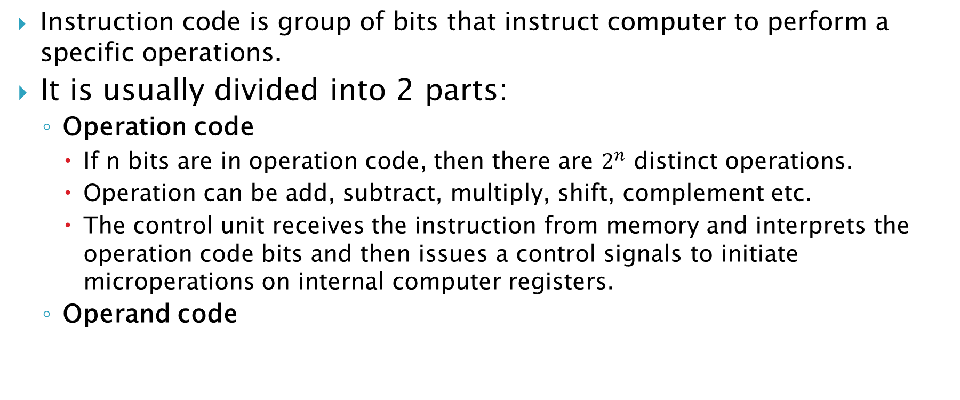
Instruction Codes
Instruction code is group of bits that instruct computer to perform a specific operations.
It is usually divided into 2 parts:
Operation code
If n bits are in operation code, then there are $2^{n}$ distinct operations.
Operation can be add, subtract, multiply, shift, complement etc.
The control unit receives the instruction from memory and interprets the operation code bits and then issues a control signals to initiate microperations on internal computer registers.
Operand code

Slide 15
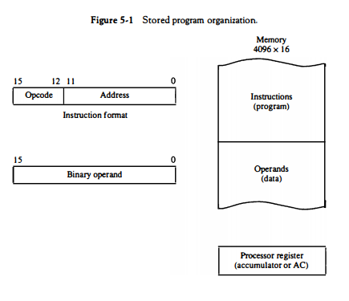
Stored Program Organization

Slide 16
Addressing Modes of basic computer (Direct and Indirect addressing mode)
When the second part of an instruction code specifies the address of an operand, the instruction is said to have a Direct address.
When the second part of an instruction code specifies the address of a memory word in which the address of the operand is available, the instruction is said to have Indirect address.

Slide 17
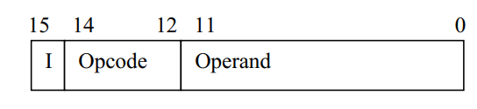
Addressing Modes of Basic computer (Direct and Indirect addressing mode)

Slide 18
Addressing Modes of Basic computer (Direct and Indirect addressing mode)
The indirect address instruction needs two references to memory to fetch an operand.
The first reference is needed to read the address of the operand.
Second reference is for the operand itself.

Slide 19
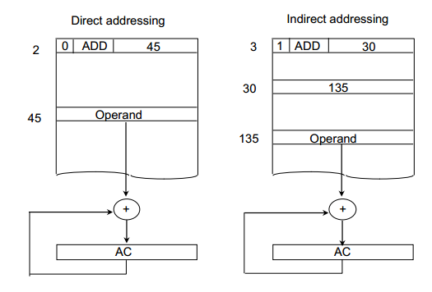
Addressing Modes of basic computer (Direct and Indirect addressing mode)

Slide 20
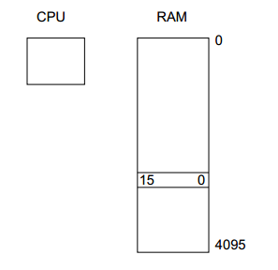
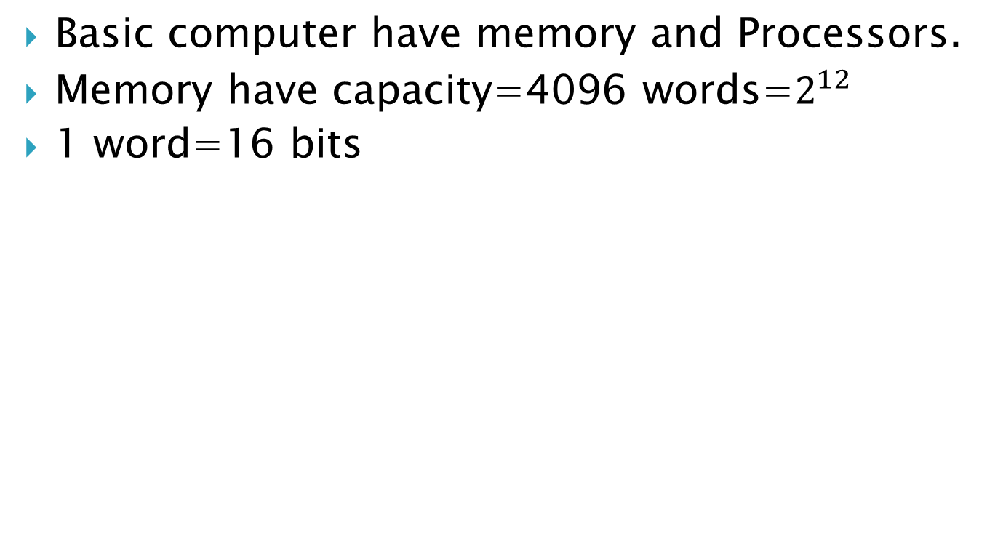
Computer Registers
Basic computer have memory and Processors.
Memory have capacity=4096 words=$2^{12}$
1 word=16 bits

Slide 21
Computers Registers
DR (Data registers)-To hold operand read from memory. 16 bits
AC (Accumulator)- General purpose register, used for storing intermediate arithmetic and logic results. 16 bits
IR(Instruction Register)- Instruction fetched from memory are placed in IR. 16 bits
TR(Temporary Registers)- used for holding temporary data. 16 bits

Slide 22
AR(Address registers)- holds address for memory. 12 bits
PC(Program counter)- Address of next instruction. 12 bits
INPR(Input Register)-receives 8 bit input from input device. 8 bits
OUTR(Output Registers)-hold 8 bit character for output. 8 bits

Slide 23
Why common bus system is used?
Basic computer has eight registers, a memory unit and a control unit.
Path must be provided to transfer information from one register to another and between memory and register.
The number of wires will be excessive if connections are between the outputs of each register and input of other registers.
So efficient way is to use common bus system.

Slide 24
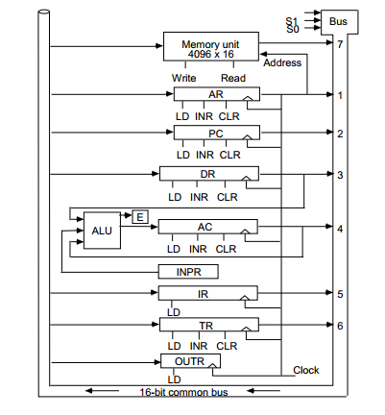
Common Bus system

Slide 25
Computer Instructions
Memory reference instructions-instruction that has operand addresses referring to a location in memory
Register Reference Instructions-specifies a operation on AC or a test of the AC
Input Output instructions-used to input data / output data

Slide 26
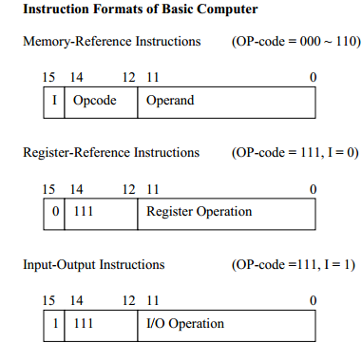
Computer Instruction Format with its types

Slide 27
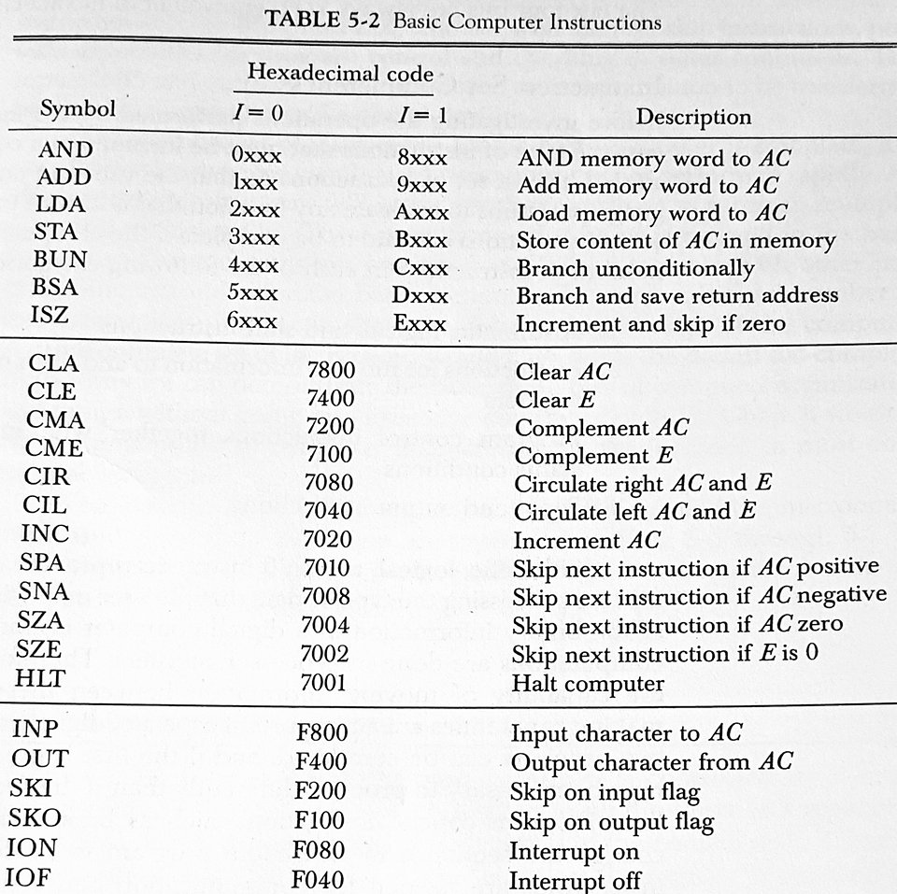
Basic Computer Instructions

Slide 28
Instruction Set Completeness
Instruction set is complete if it contains sufficient set of instructions in each of following categories-
Arithmetic, logical and shift instruction
Instruction for moving information to and from memory and processor registers.
Program control instructions together that check status conditions(E.g Branch)
Input and Output Instructions

Slide 29
Control Unit
Control Unit is implemented In 2 ways:-
Hardwired Control – CU is made up of sequential and combinational circuits to generate the control signals. – If logic is changed we need to change the whole circuitry – Expensive – Fast
Micro programmed Control – A control memory on the processor contains micro-programs that activate the necessary control signals. – If logic is changed we only need to change the micro-program. – Cheap – Slow

Slide 30
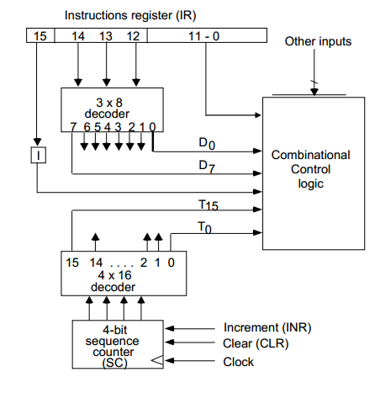
Control Unit of Basic Computer

Slide 31
Instructions cycle
Program is executed in computer by going through a cycle for each instruction. Each instruction cycle is subdivided into different phases-
1. Fetch an instruction from memory. 2. Decode the instruction. 3. Read the effective address from memory if the instruction has an indirect address. 4. Execute the instruction.

Slide 32
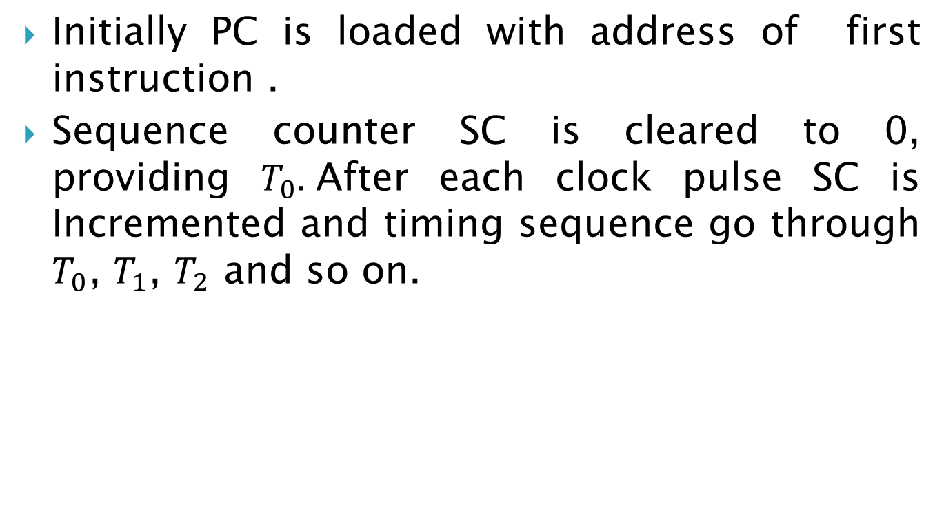
Fetch and decode
Initially PC is loaded with address of first instruction .
Sequence counter SC is cleared to 0, providing $T_{0}.$After each clock pulse SC is Incremented and timing sequence go through $T_{0}$, $T_{1}$, $T_{2}$ and so on.

Slide 33
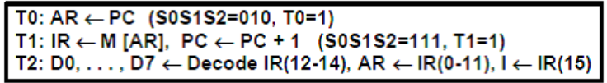
Fetch and Decode
The micro operations for the fetch and decode phases can be specified by the following register transfer statements:

Slide 34
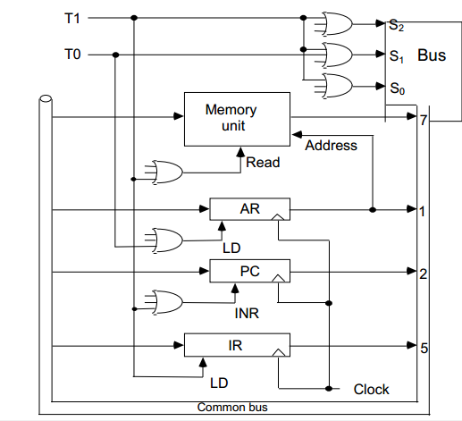
Fetch Phase

Slide 35
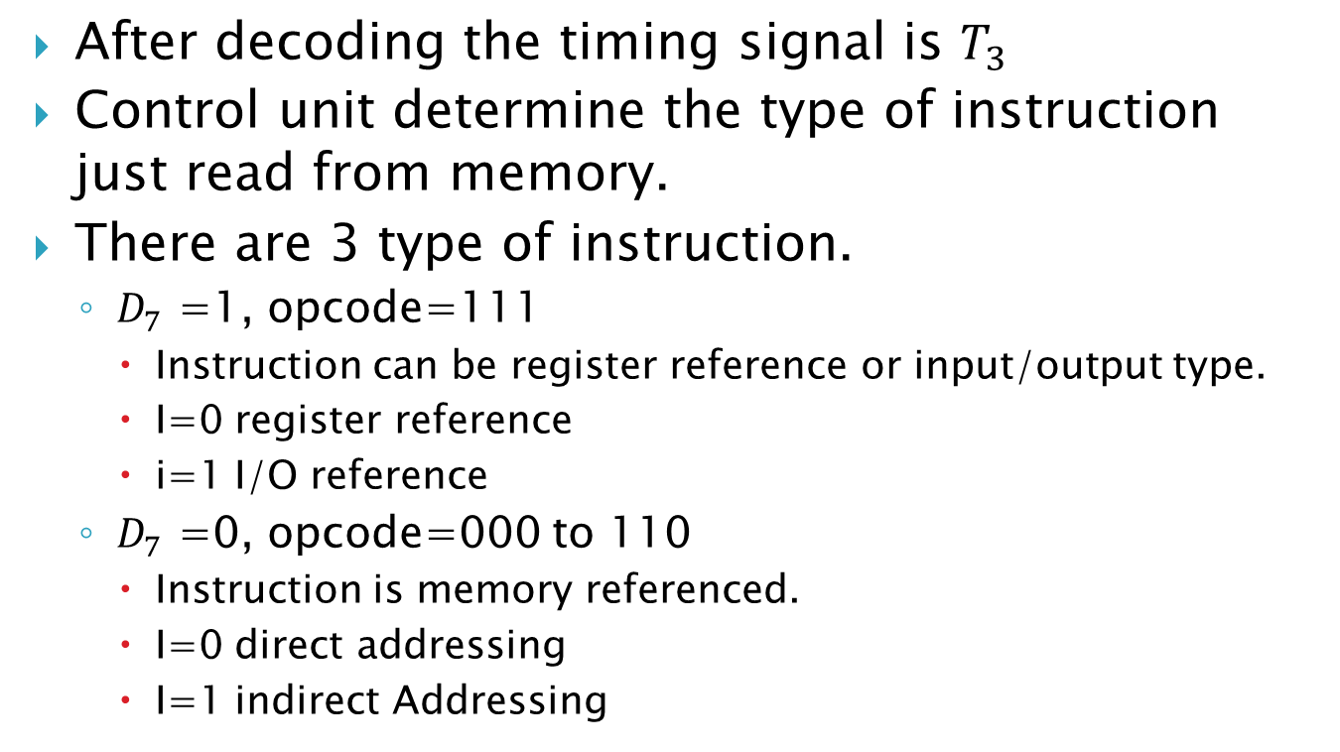
Determine the type of instruction
After decoding the timing signal is $T_{3 }$
Control unit determine the type of instruction just read from memory.
There are 3 type of instruction.
$D_{7}$ =1, opcode=111
Instruction can be register reference or input/output type.
I=0 register reference
i=1 I/O reference
$D_{7}$ =0, opcode=000 to 110
Instruction is memory referenced.
I=0 direct addressing
I=1 indirect Addressing

Slide 36
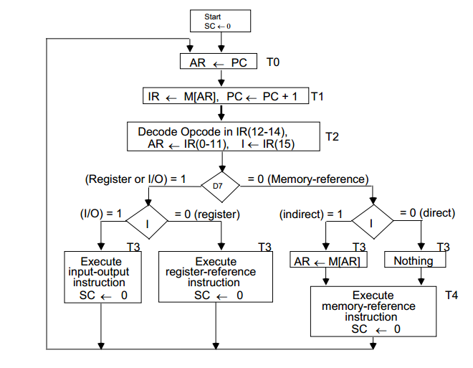
Flowchart of instruction cycle

Slide 37
Register –Reference Instructions
Register Reference Instructions are identified when - D7 = 1, I = 0 - Register Ref. Instr. is specified in b0 ~ b11 of IR - Execution starts with timing signal T3

Slide 38
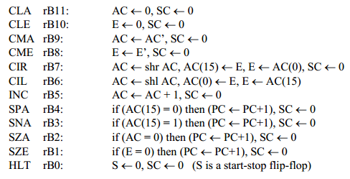
Register –Reference Instructions

Slide 39
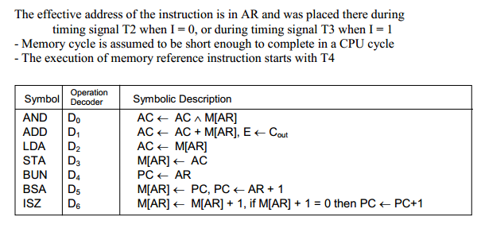
Memory Reference Instructions

Slide 40
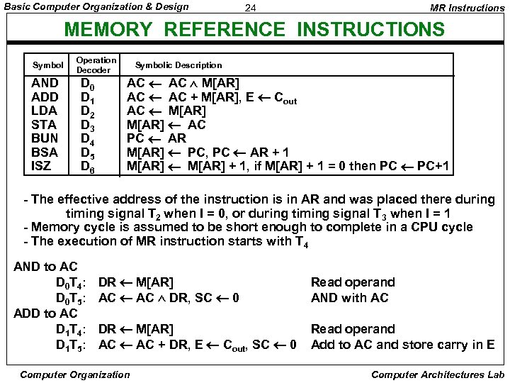

Slide 41
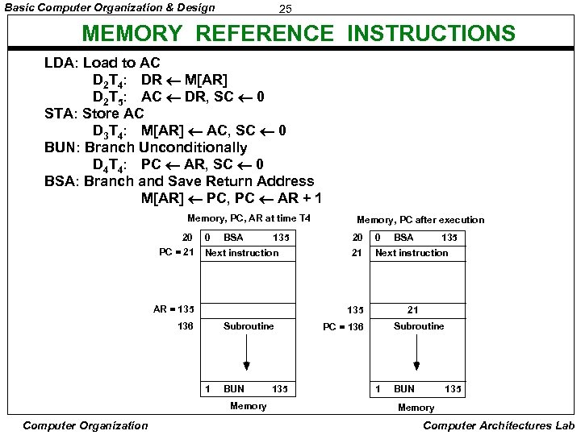

Slide 42
